Slide 2
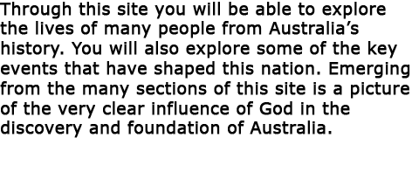

Slide 3
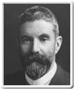
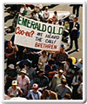
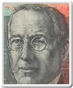

Slide 5
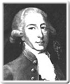
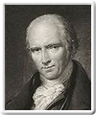
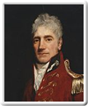

Slide 9
Explore the timeline like this:
Click on an image at the bottom
-or-
Click on the red dots beside the timeline.
The blue lines on the timeline show spans of time.
To return to the main menu click the ‘M’ in the top right corner.
Click the ‘TIMELINE’ to begin exploring…
index

Slide 27
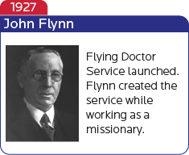

Slide 34
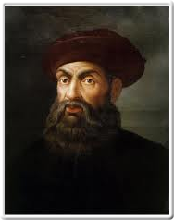
index

Slide 35
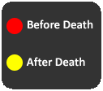
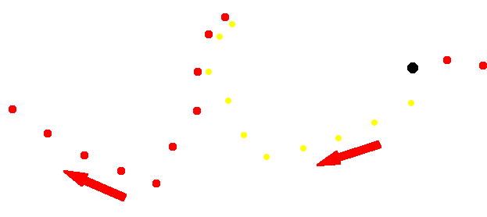
index

Slide 36
index

Slide 37
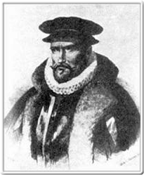
index

Slide 38
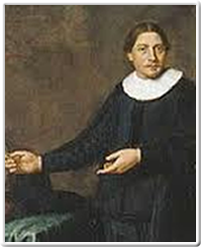
index

Slide 39
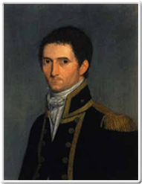
index

Slide 40
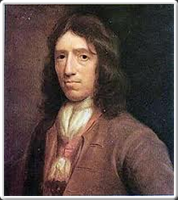
index

Slide 41
index

Slide 42
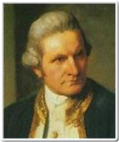
index

Slide 43
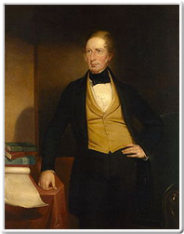
index

Slide 44
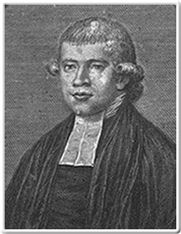
index

Slide 45
index

Slide 46
index

Slide 47
index

Slide 48
index

Slide 49
index

Slide 50
index

Slide 51
index

Slide 52
index

Slide 53
index

Slide 54
index

Slide 55
index

Slide 56
index

Slide 57
index

Slide 58
index

Slide 59
index

Slide 60
index

Slide 61
index

Slide 62
index

Slide 63
index

Slide 64
index

Slide 65
index

Slide 66
index

Slide 67
index

Slide 68
index

Slide 69
index

Slide 70
index

Slide 71
index

Slide 72
index

Slide 73
index

Slide 75
Christian History Research
The Australian War Memorial
The Australian Dictionary of Biography
Wikipedia
Also for further study below:
John Flynn:
An Interactive Biography
Produced by
Interactive History

